Slide 1
Mode, Quartile

Slide 2
1. Mode Basics
The mode of a dataset is the value that appears most frequently. Unlike the mean (average) or median (middle value), the mode is specifically about which value occurs the most.
Example
Consider this dataset of shoe sizes:
[8, 9, 10, 8, 9, 8, 7, 8, 10, 8]

Slide 3
2. Types of Mode
Unimodal: A dataset with only one mode (a single most common value).
Bimodal: A dataset with two modes (two different values with the highest frequency).
Multimodal: A dataset with more than two modes.
Example of Bimodal
Imagine this set of students’ test scores:
[78, 82, 85, 82, 90, 90, 92, 85, 82, 90]
Here, both 82 and 90 are modes since they each appear three times, making the dataset bimodal.

Slide 4
3. Mode in Real-Life Context
Let’s take mode to a relatable scenario to show how it works in real life.
Analogy
Imagine you’re at an ice cream shop, noting which flavors people order throughout the day. If “vanilla” is ordered more than any other flavor, vanilla becomes the mode of the shop’s sales for the day — it’s the shop’s most popular flavor, just as the mode is the “most popular” value in a dataset.

Slide 5
4. When Mode is Useful
The mode is particularly useful when:
Data is categorical: For example, survey data where answers are categories (e.g., “red,” “blue,” “green”) and there’s no numeric ordering, so you want to know the most common category.
Non-numeric insights: If you’re collecting data on favorite hobbies, favorite foods, or color preferences, mode helps identify the most favored option without averaging values.
Example in Surveys
In a survey asking, “What’s your favorite pet?” responses might look like this:
[cat, dog, dog, bird, fish, dog, cat, dog, fish]
The mode here is “dog” since it appears the most often, revealing the group’s favorite pet.

Slide 6
5. Comparing Mode with Mean and Median
Sometimes, the mode gives insights that the mean and median miss, especially in datasets with outliers or skewed distributions.
Example
Imagine people’s ages in a community meeting:
[18, 22, 22, 22, 25, 26, 70]
Mean (Average): (18 + 22 + 22 + 22 + 25 + 26 + 70) / 7 = 29.29
Median: 22 (the middle value when sorted)
Mode: 22
Here, the mode tells us the age that appears most often (22), which may be more representative of the group than the average of 29.29 due to the single high age (70) skewing the mean.

Slide 7
Summary
Mode is the “most popular” or frequently occurring value in a dataset.
Great for categories and when you want to highlight the most common response.
Useful in skewed datasets to represent typical values without being thrown off by outliers.

Slide 8
When Mean May Mislead
In a dataset with outliers or a skewed distribution, the mean can be misleading because it gets "pulled" toward outliers.

Slide 9
When Median May Mislead
The median doesn’t consider every data point, so in datasets with many repeated values, it may overlook certain patterns.

Slide 10
When to Use Mode
Categorical Data: The mode is ideal for nominal data (categories) without any natural order, like finding the most popular color, brand, or choice in a survey.
Multimodal Distributions: When data has multiple peaks or clusters, mode helps identify each group’s center.
Insight into Preference or Frequency: For questions like "What’s the most common shirt size?" or "Which day of the week do people shop the most?", mode shows the most frequent choice.

Slide 11
When Mode May Mislead
The mode doesn’t work well for continuous data with few or no repeated values, as it might not represent a true “central” value if each number appears just once.

Slide 12
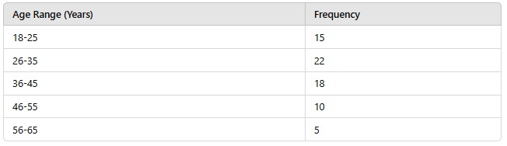
Example for Grouped Data
Suppose you work as an event organizer and have data on the age ranges of attendees at a recent event, summarized as follows:

Slide 13
Question
Determine the modal age range of the event attendees and explain what this reveals about the event’s target audience.

Slide 14
Answer
The modal age range is 26-35, as it has the highest frequency of 22. This indicates that the majority of the event attendees are in the 26-35 age range, suggesting this age group aligns well with the event’s theme or offerings.

Slide 15
Quartile

Slide 16
What is Quartile?
Quartiles are statistical values that divide a dataset into four equal parts, helping to provide a deeper understanding of the distribution and spread of data.
Imagine you’re slicing a pizza into four equal portions so each person gets the same amount. Similarly, quartiles slice data into four parts, each containing an equal number of data points.

Slide 17
Breaking Down Quartiles
In a dataset:
Q1 (First Quartile): Separates the lowest 25% of data from the rest. It’s like saying, "The first slice goes to the person with the smallest appetite!"
Q2 (Second Quartile or Median): Divides the data in half (50th percentile). This is the middle point of the data.
Q3 (Third Quartile): Separates the highest 25% of data from the rest, leaving the remaining 75% below it.
Each quartile value represents a point that defines one-fourth of the data distribution, enabling us to see where data tends to cluster and the extent of any outliers.

Slide 18
How to Calculate Quartiles
For a dataset, here’s how you calculate each quartile:
Arrange the data in ascending order.
Identify Q2 (Median): This is the middle point, dividing data into two halves.
Identify Q1 and Q3:
Q1 is the median of the lower half (below Q2).
Q3 is the median of the upper half (above Q2).

Slide 19
Example Calculation
Let’s say we have a dataset of the following 11 response times (in minutes):
[5, 7, 9, 10, 11, 12, 15, 18, 19, 20, 22]
Arrange data in order: [5, 7, 9, 10, 11, 12, 15, 18, 19, 20, 22]
Calculate Q2 (Median):
The median, or Q2, is the middle value of the data. For 11 values, the median is the 6th value: 12
Calculate Q1 (First Quartile):
The lower half of data (below 12) is: [5, 7, 9, 10, 11]
The median of this half is 9 , so Q1 = 9
Calculate Q3 (Third Quartile):
The upper half of data (above 12) is: [15, 18, 19, 20, 22]
The median of this half is 19 , so Q3 = 19
So, in this example:
Q1 = 9, Q2 = 12 (median), Q3 = 19

Slide 20
Analogies to Make It Clearer
Mountain Hikers: Imagine a group of hikers climbing a mountain trail. Q1 represents the point where the first quarter of hikers have reached, Q2 is where half the hikers have reached, and Q3 is where three-quarters of the hikers are. This helps us visualize how far each section of the group has progressed.
Library Book Collection: In a library, if books are arranged by publication year, Q1 represents the year by which 25% of books were published, Q2 is the median publication year, and Q3 is when 75% of the books had been published. This helps in understanding when the bulk of the books were published, showing early, median, and late publishing trends.

Slide 21
Interquartile Range (IQR)
The Interquartile Range (IQR) is the difference between Q3 and Q1 and represents the range of the middle 50% of data. It’s a useful measure because it excludes outliers, giving us an idea of where the core data values lie.
In our example:
IQR = Q3 - Q1 = 19 - 9 = 10
The IQR tells us that the middle 50% of response times fall within a 10-minute range, from 9 to 19 minutes.

Slide 22
Why Quartiles Are Useful
Quartiles are useful in identifying:
Skewness: If Q1 is much lower than Q3, the data might be skewed towards the lower end (and vice versa).
Outliers: Points outside 1.5 * IQR from Q1 or Q3 are considered outliers. For instance, if we calculate a "fence" around our data using this rule, it helps highlight any unusually high or low data points.

Slide 23
Summary
Using quartiles helps visualize and segment the dataset, providing a richer understanding of data distribution than single measures like the mean or median alone.
It also offers valuable insights, especially in large datasets, by showing how data points cluster around specific values.

Slide 24
Question
A farmer collects data on the weights (in kilograms) of apples harvested from 20 different trees. The data is as follows:
Weights: 2.1, 2.5, 2.9, 3.0, 3.2, 3.5, 3.6, 3.7, 3.9, 4.0, 4.1, 4.2, 4.3, 4.5, 4.7, 4.8, 5.0, 5.2, 5.5, 6.0
The farmer wants to divide the trees into groups based on apple weights so that they can analyze the bottom 25%, middle 50%, and top 25% of the weights.
Task:
Determine the three weight intervals corresponding to the farmer's grouping criteria. Provide the detailed reasoning behind your calculation process and explicitly state any assumptions made.

Slide 25
Solution
Step 1: Understand the Question
The farmer wants to group the weights into three intervals:
Bottom 25%: Below the first quartile (Q1).
Middle 50%: Between the first quartile (Q1) and the third quartile (Q3).
Top 25%: Above the third quartile (Q3).
This means we need to calculate Q1 (25th percentile), Q2 (median/50th percentile), and Q3 (75th percentile).

Slide 26
Step 2: Arrange the Data
The weights are already sorted: 2.1, 2.5, 2.9, 3.0, 3.2, 3.5, 3.6, 3.7, 3.9, 4.0, 4.1, 4.2, 4.3, 4.5, 4.7, 4.8, 5.0, 5.2, 5.5, 6.0
The dataset contains n=20 data points.

Slide 27
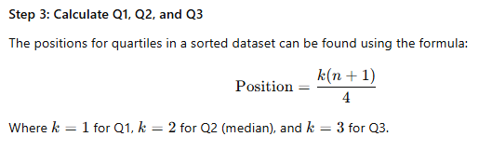
Step 3: Calculate Q1, Q2, and Q3
The positions for quartiles in a sorted dataset can be found using the formula:

Slide 28
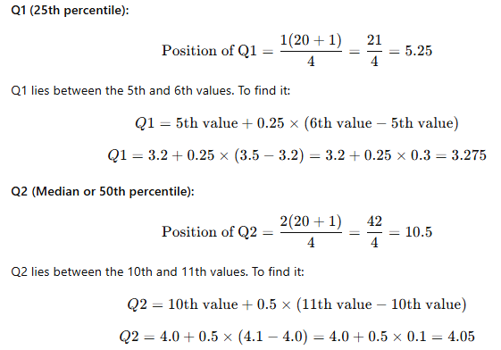

Slide 29
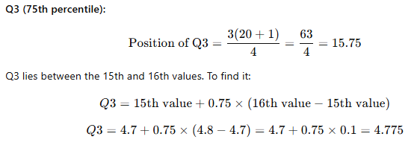

Slide 30
Step 4: Group the Weights
Using the calculated quartiles:
Bottom 25% (less than Q1): Weights below 3.275 → 2.1, 2.5, 2.9, 3.0, 3.2
Middle 50% (between Q1 and Q3): Weights between 3.275 and 4.775 → 3.5, 3.6, 3.7, 3.9, 4.0, 4.1, 4.2, 4.3, 4.5, 4.7
Top 25% (greater than Q3): Weights above 4.775 → 4.8, 5.0, 5.2, 5.5, 6.0

Slide 31
Final Answer
The weight intervals are:
Bottom 25%: [2.1, 3.2]
Middle 50%: [3.275, 4.775]
Top 25%: [4.8, 6.0]
These intervals provide the groups the farmer needs for analysis.

